Slide 1
Olympians
Please view the slides below
Be able to identify Olympians based upon the objects associated with them
Use the handout on the Olympians (found on Blackboard) to assist you.

Slide 2
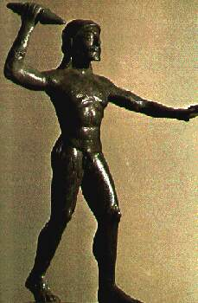
Zeus with thunderbolt

Slide 3
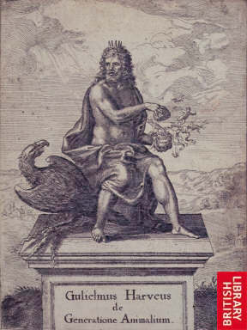
Zeus with eagle

Slide 4
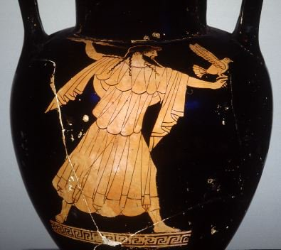
Zeus with thunderbolt and eagle

Slide 5
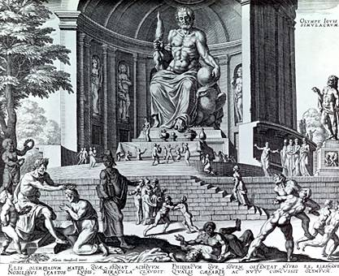
Zeus with thunderbolt and eagle

Slide 6
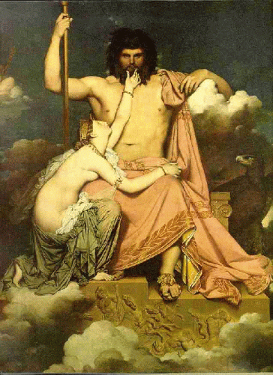
Zeus with eagle supplicated by Thetis

Slide 7
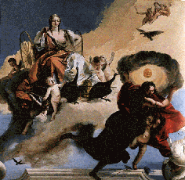
Hera with peacocks

Slide 8
Hestia
No image for. You will not have to identify on the quiz.

Slide 9
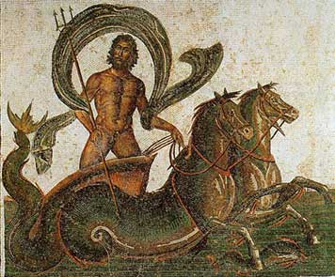
Poseidon with trident and hippokampoi (fish-tailed horses)

Slide 10
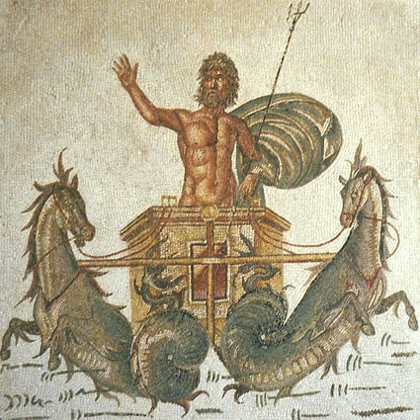
Poseidon with trident and hippokampoi (fish-tailed horses)

Slide 11
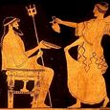
Poseidon with trident

Slide 12
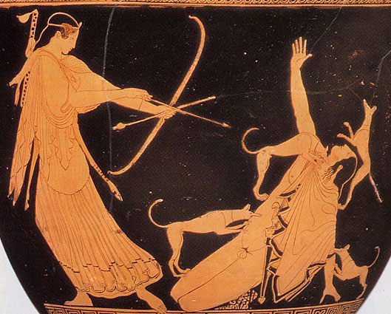
Artemis with bow

Slide 13
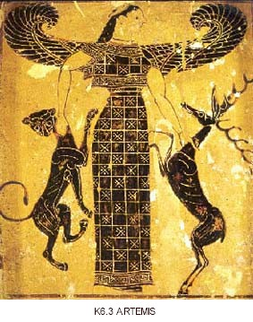
Artemis, protector and destroyer of animals

Slide 14
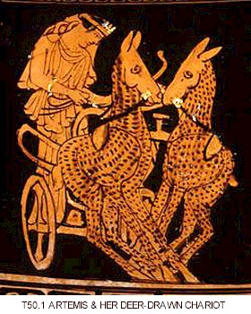
Artemis in deer drawn chariot with bow

Slide 15
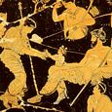
Birth of Dionysus from Zeus’ thigh

Slide 16
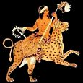
Dionysus riding panther

Slide 17
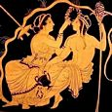
Dionysus with thyrsos (pine-cone tipped staff)

Slide 18
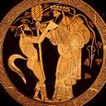
Dionysus with thyrsus and satyr (man with ears and tail of an ass)

Slide 19
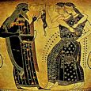
Dionysus with wine-cup and maenads (female-worshippers)

Slide 20
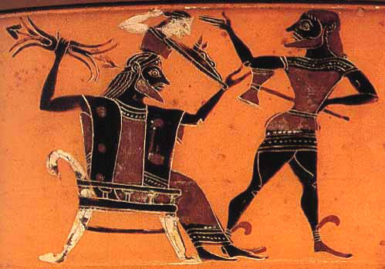
Hephaestus with smith hammer (Athene is being born from Zeus’ head)

Slide 21
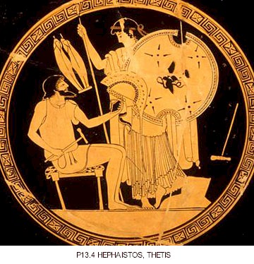
Hephaestus with hammer making arms for Thetis’ son, Achilleus

